Slide 1
Hot Jupiter
2022311224 이진진

Slide 2
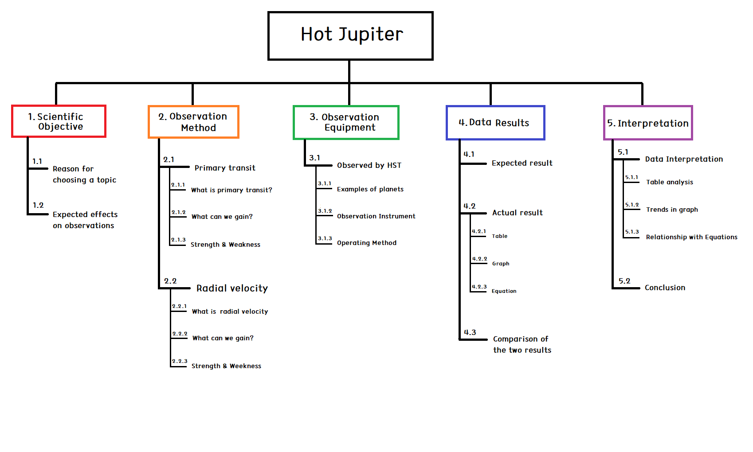
PLAN
Week 7 : Total WBS introduction / Scientific Objective 1.1, 1.2
Week 8 : Modifying overall WBS and PLAN / Observation Method 2.1, 2.2, 2.3
Week 9 : Observation Method 2.1, 2.2
Week 10 : Observation Equipment 3.1
Week 11 :
Week 12 : Data Result 4.1
Week 13 : Data Result 4.2, 4.3
Week 14 : Interpretation 5.1, 5.2
Week 15 : (Blank Period)
Week 16 : Conference

Slide 3
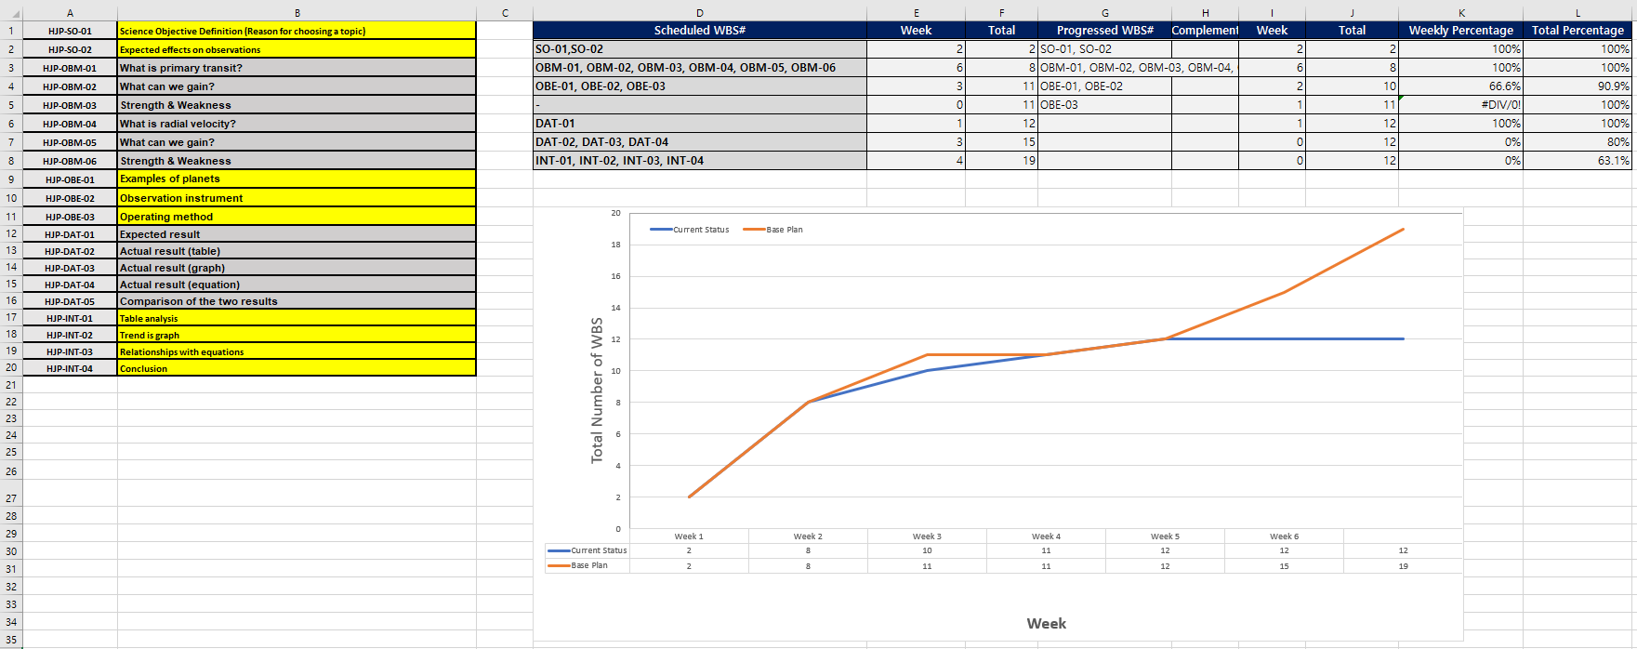
WBS

Slide 4
4.1
Expected Data – 51 Pegasi b
Radius
Distance
Orbiting velocity
4. Mass
5. Temperature & Atmospheric composition

Slide 5
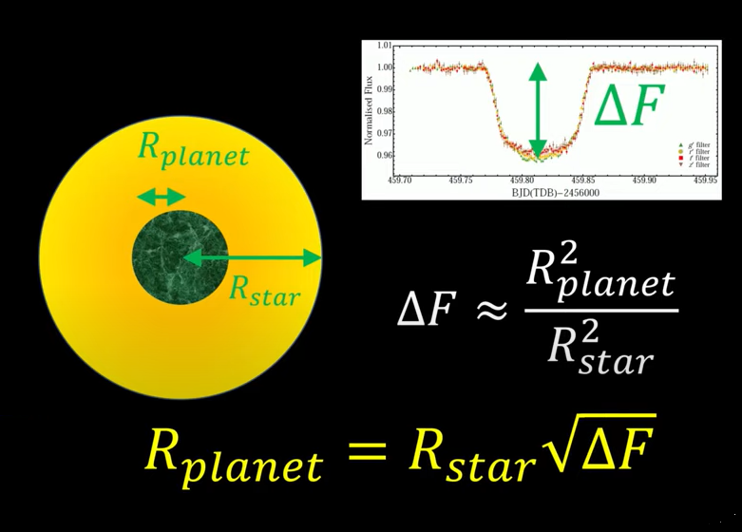
4.1
Expected Data - 51 Pegasi b
Radius (Primary transit)

Slide 6
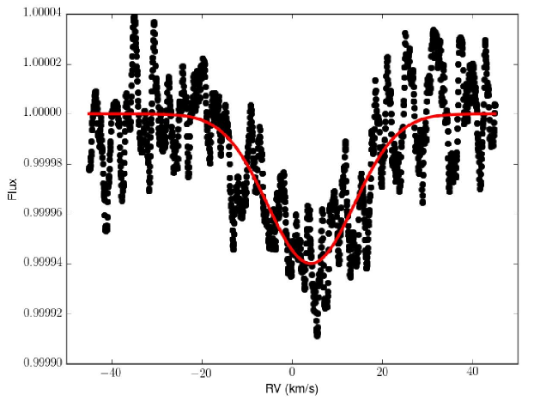
4.1
Expected Data - 51 Pegasi b
Radius (Primary transit)
R(Star) x sqrt(ΔF)
= 1.237 x (0.00006)^(1/2)
= 0.0096 R(sun)
= 0.0096 x 696,340 km
= 6685 km (X)
ΔF ~ 0.00006

Slide 7
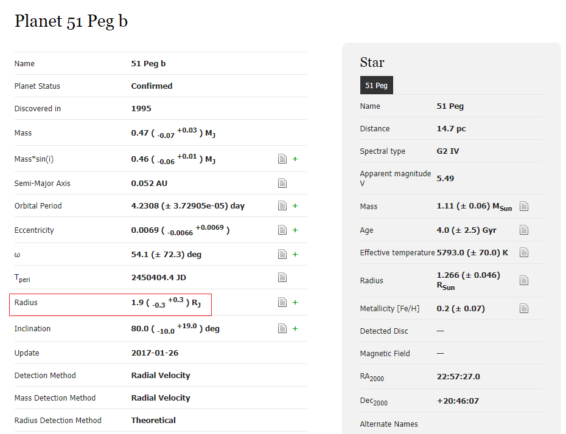
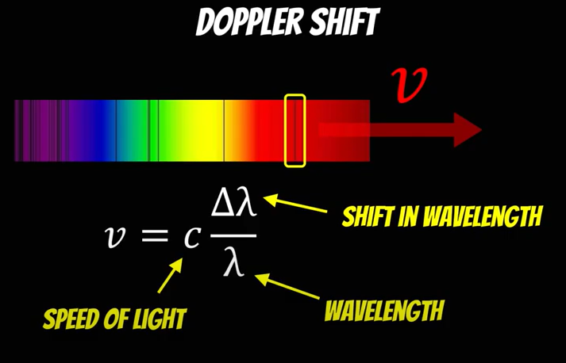
4.1
Expected Data - 51 Pegasi b
R = 135,830 km
Radius (Primary transit)

Slide 8
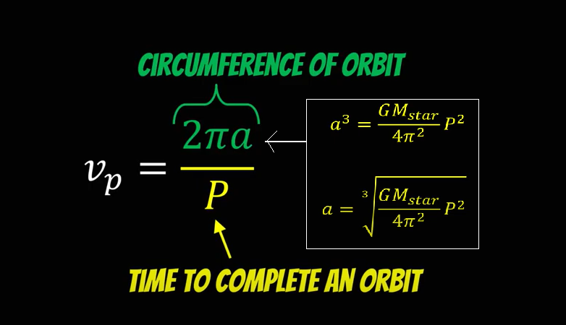
4.1
Expected Data - 51 Pegasi b
2. Distance from sun

Slide 9
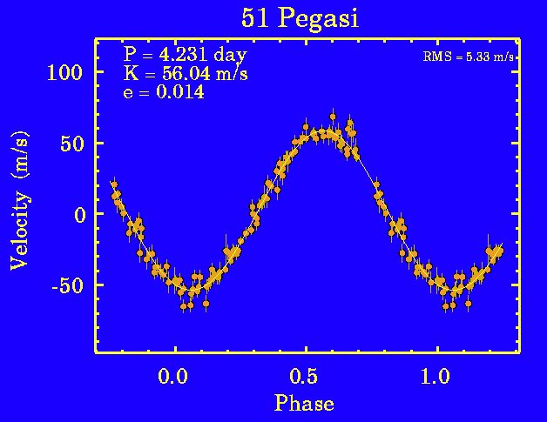
4.1
Expected Data - 51 Pegasi b
2. Distance
P = 4.231 days = 365560 s
a = [GM(star) p^2 / 4 pi^2]^(1/3)
= [6.67 x 10^(-11) x 365560^2 M(star) / 4 pi^2]^(1/3)
= 7,943,504,324 m = 7,943,504 km
= 0.053AU

Slide 10
4.1
Expected Data - 51 Pegasi b
3. Orbiting velocity
A = 0.053AU = 7,943,504,324 m
v = 2 pi (7,943,504,324m) / 365560s
= 136,531 m/s = 136.5 km/s

Slide 11
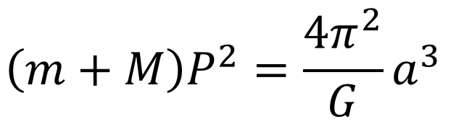
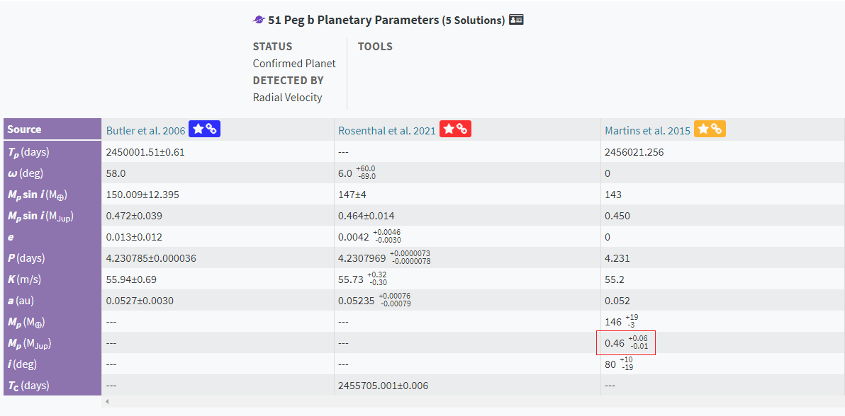
4.1
Expected Data - 51 Pegasi b
4. Mass
M = 0.46M(jup) = 0.00044M(sun)

Slide 12
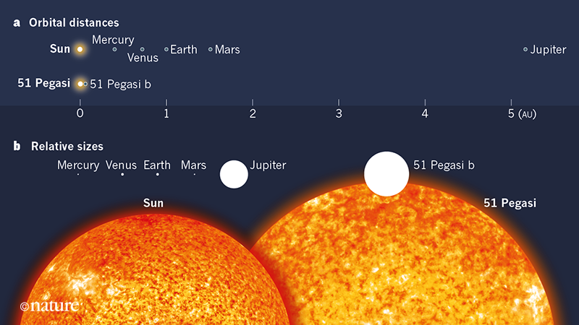
4.1
Expected Data - 51 Pegasi b

Slide 13
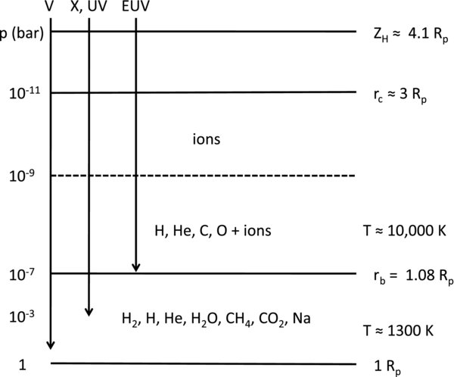
4.1
Expected Data HD209458 b
5. Surface Temperature & chemical composition

Slide 14
WBS

Slide 15
THANK YOU
FOR LISTENING

